Slide 1
Report Font
This presentation uses Adobe's Report font. Present in read-only format to ensure the font displays correctly. If you have an Adobe account and wish to edit this resource using Report font, you can activate the font on your computer here: https://fonts.adobe.com/fonts/report. If you do not have an Adobe account, you can download the resource and edit using your preferred font.

Slide 2
Animations Disclaimer
We hope you find the information on our website and resources useful.
PowerPoint
This resource has been designed with animations to make it as fun and engaging as possible. To view the content in the correct formatting, please view the PowerPoint in “slide show mode.” This takes you from desktop to presentation mode. If you view the slides out of “slide show mode,” you may find that some of the text and images overlap each other and/or are difficult to read.
To enter slide show mode, go to the slide show menu tab and select either from beginning or from current slide.
Slides
This resource has been designed with animations to make it fun and engaging for children.
To ensure the content has the correct formatting, please view the presentation in “present mode.” This takes you from edit mode to presentation mode. If you view the slides out of “present mode,” you may find that some of the text and images overlap each other and/or are difficult to read.
To enter present mode, go to the “Present” tab and select “Present from beginning” or simply click “Present” to play from the current slide.
You may wish to delete this slide before beginning the presentation.

Slide 4
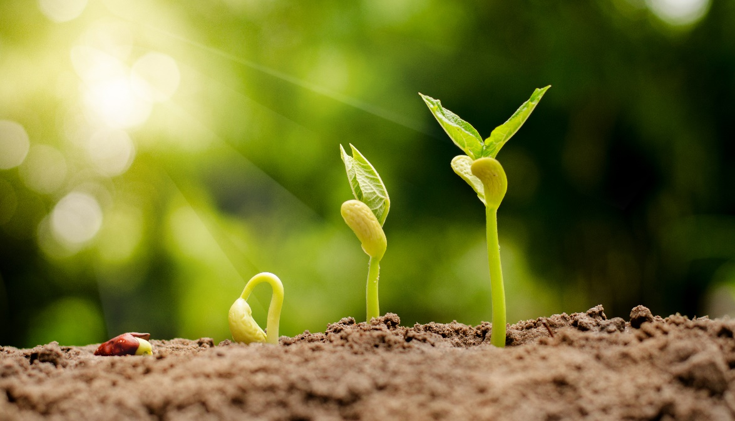
What Is Pollination?
Pollination is a very important part of plant reproduction. Reproduction means to produce again.
Pollination makes sure that new plants grow each year. If there were no plants, we could not live!
Plants have parts that help them to reproduce.

Slide 5

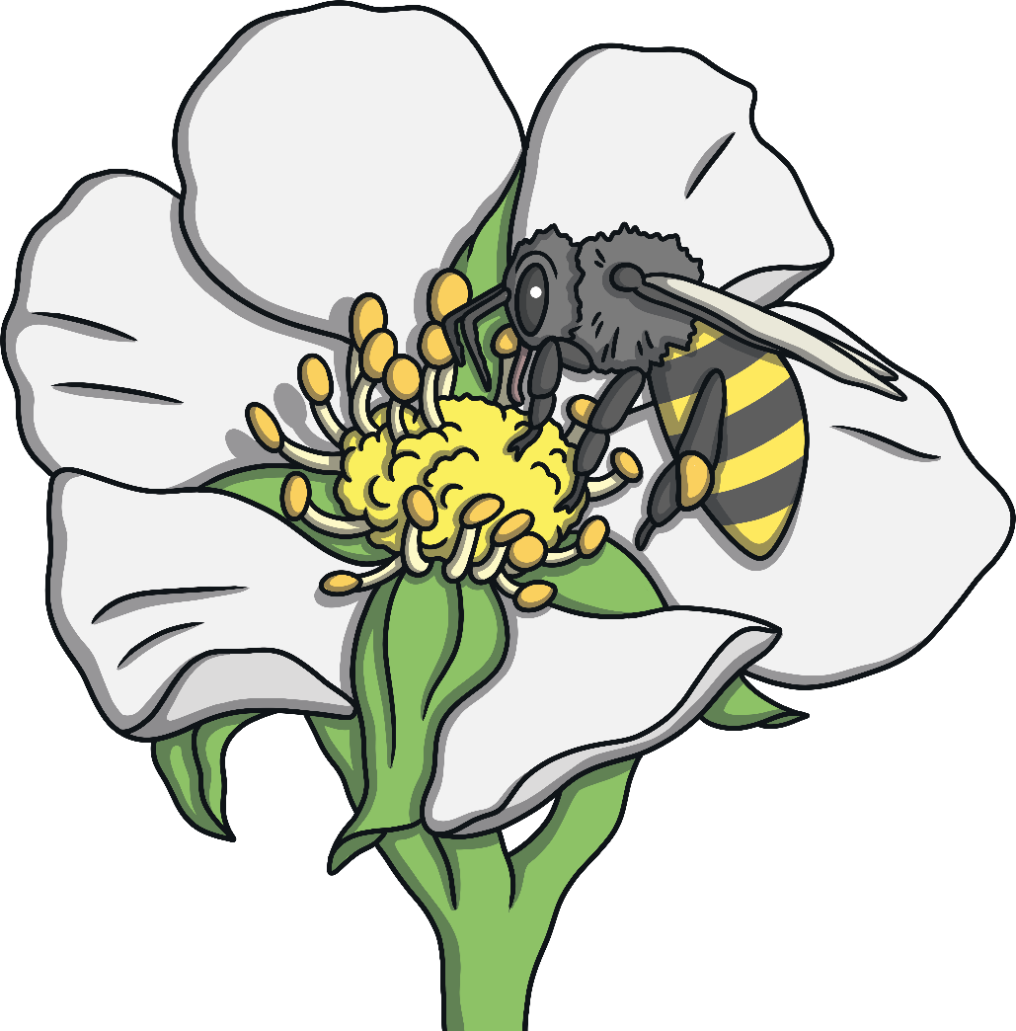
Turn and Talk
Why is pollination important?

Slide 6
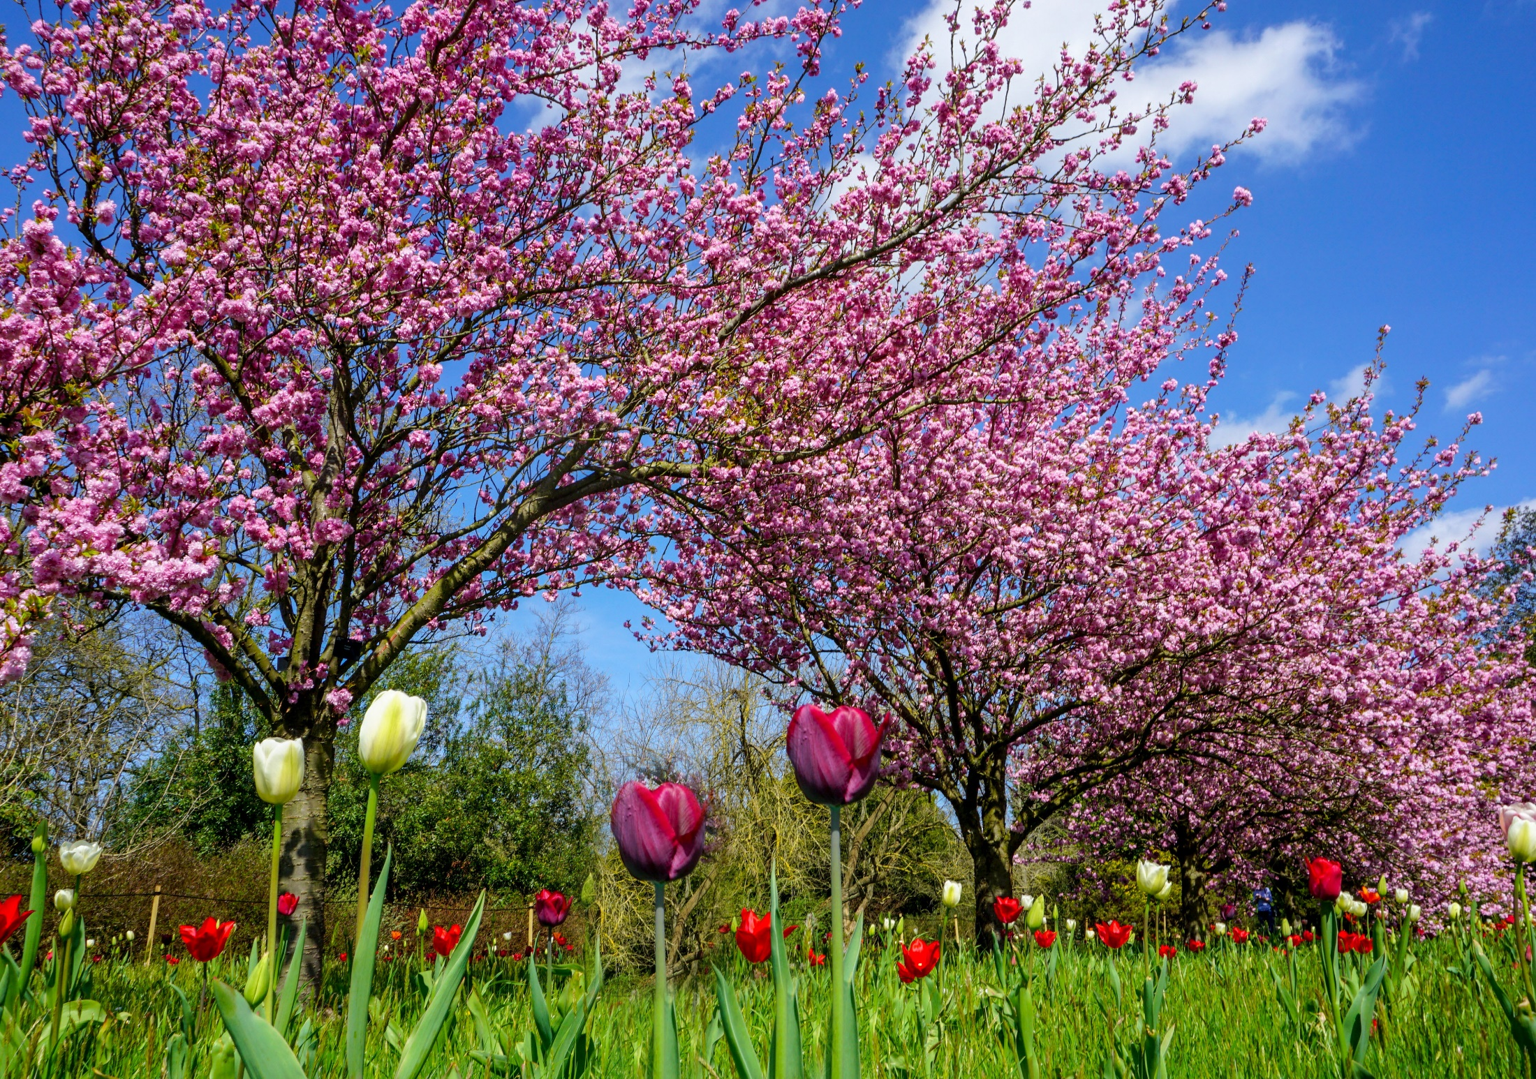
Plant Parts
Plants are made from many different parts. During pollination, each part has a special job.

Slide 7
Turn and Talk
Tell your partner one part of a plant that you already know.

Slide 8
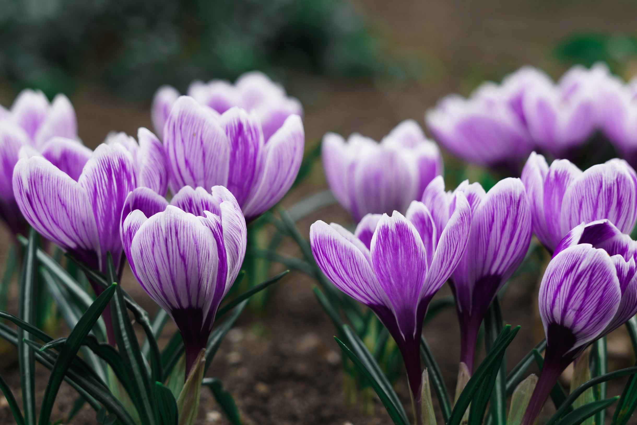
Petals
Flowers have bright-colored petals. These bright petals make insects and other pollinators notice the plant and come to eat nectar!

Slide 9
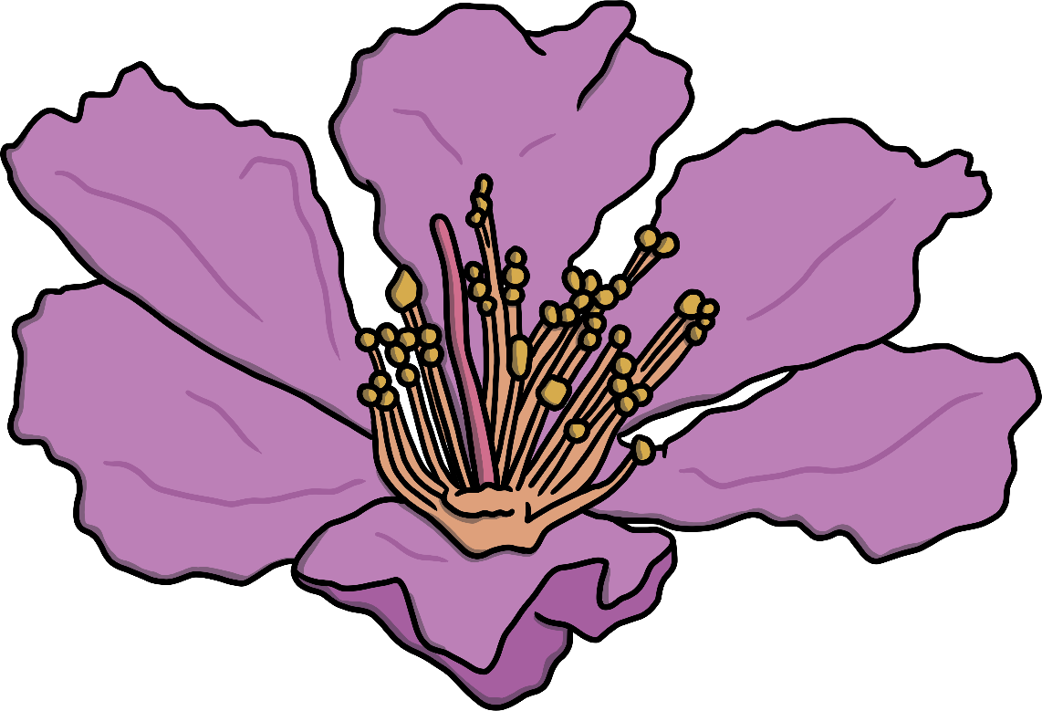
Turn and Talk
How does an insect know where to find nectar to eat?

Slide 10
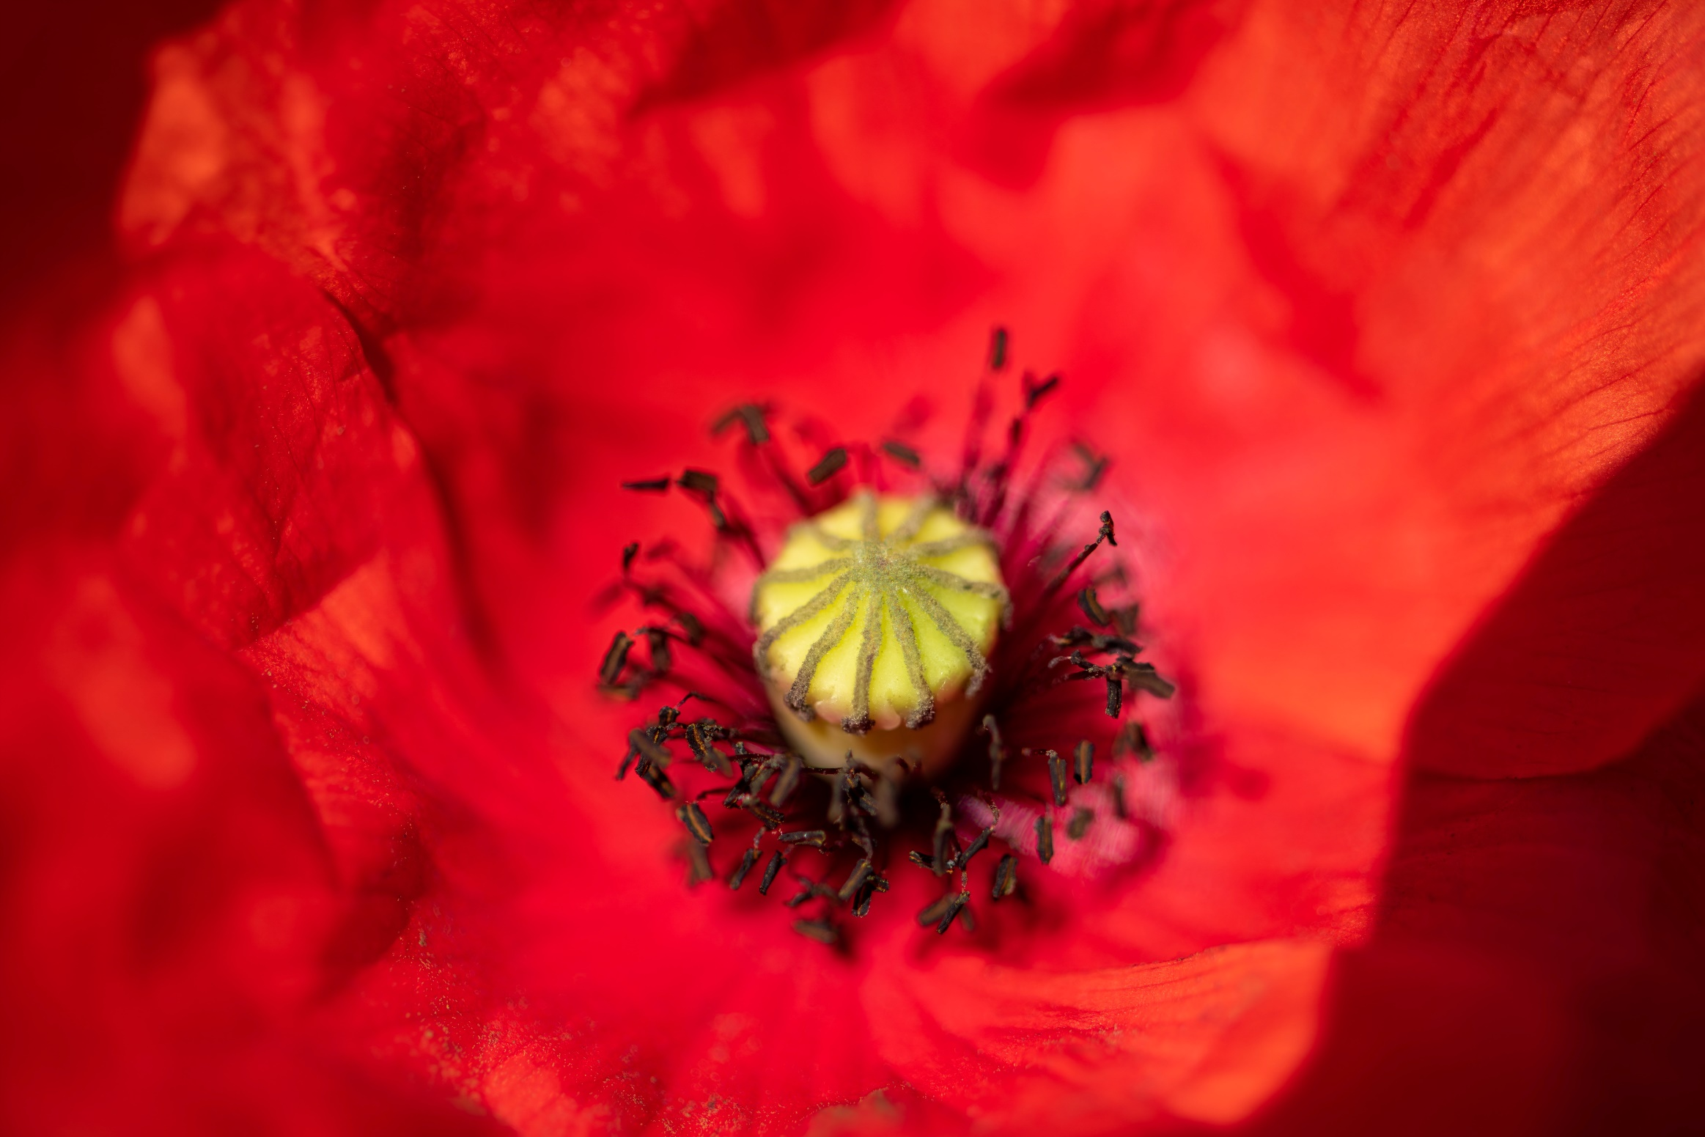
Ovary
The ovary’s job is to hold the ovules. These are parts of the plant that will turn into seeds.
The ovary keeps them safe until the flower is pollinated.

Slide 11
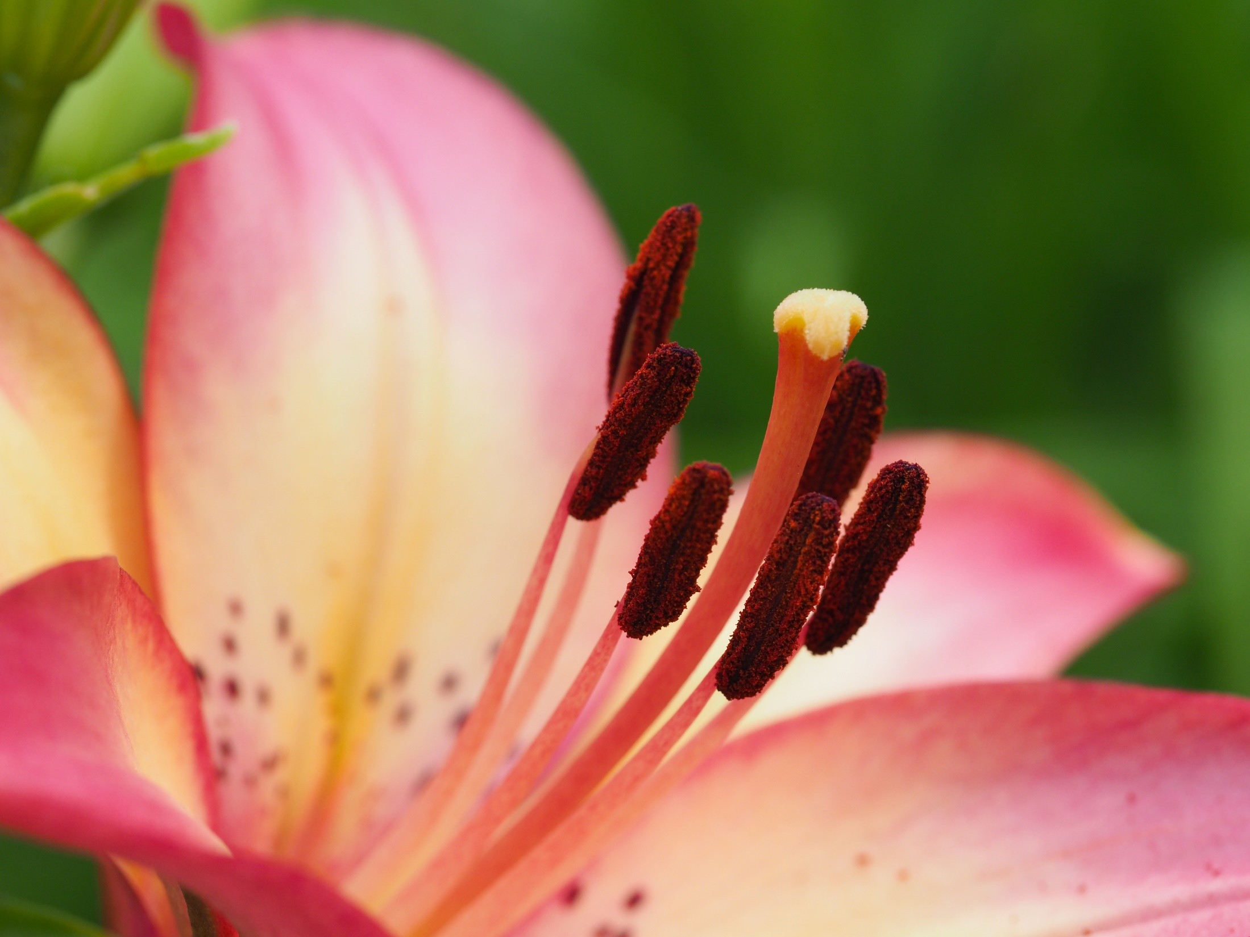
Stigma
The stigma is near the top of the flower. Its job is to get the pollen from insects that land on the flower.

Slide 12
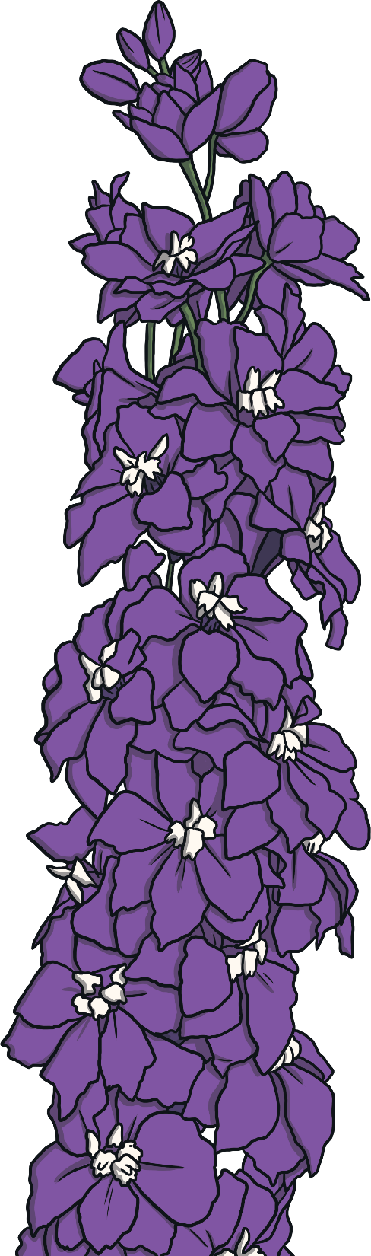
Turn and Talk
Tell your partner what an ovary and stigma do.

Slide 13
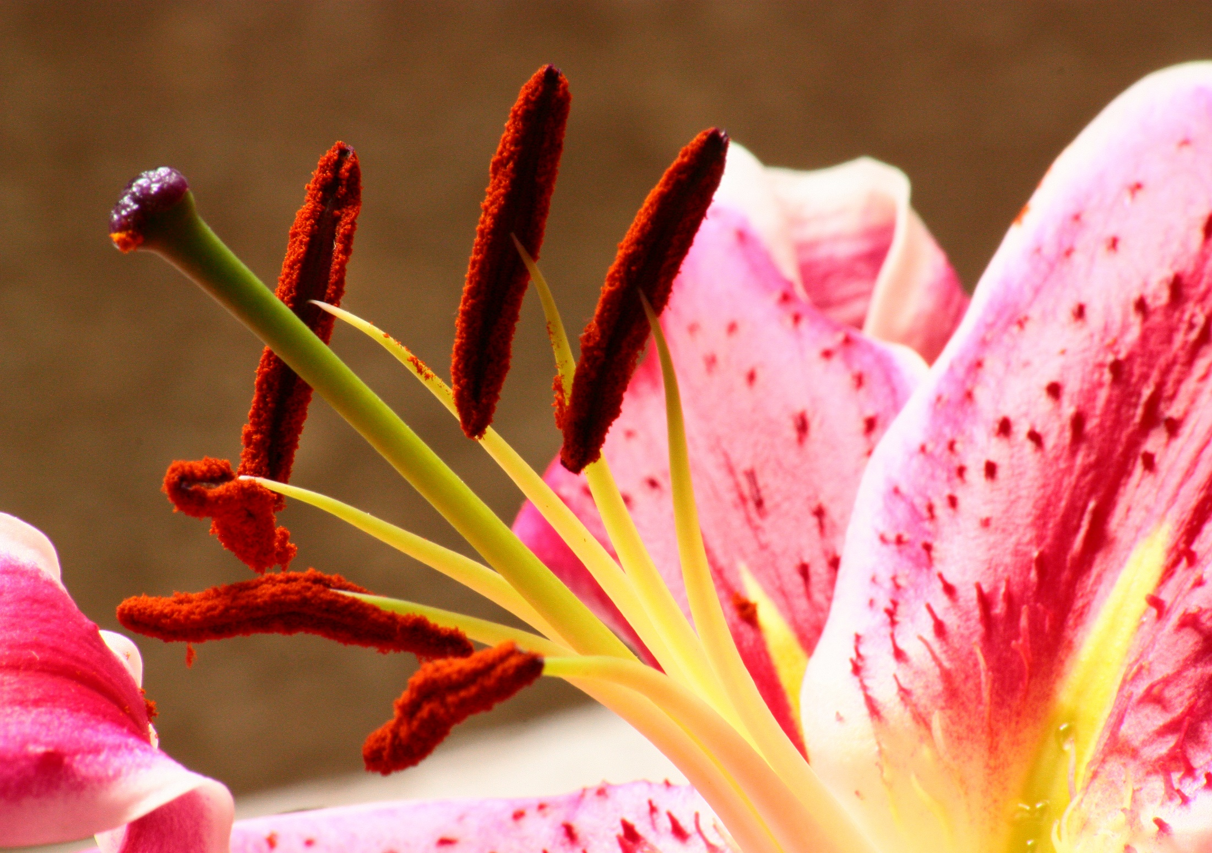
Style
The style looks like a long stem inside the flower. Its job is to hold up the stigma and make it easier to get to the pollen.

Slide 14
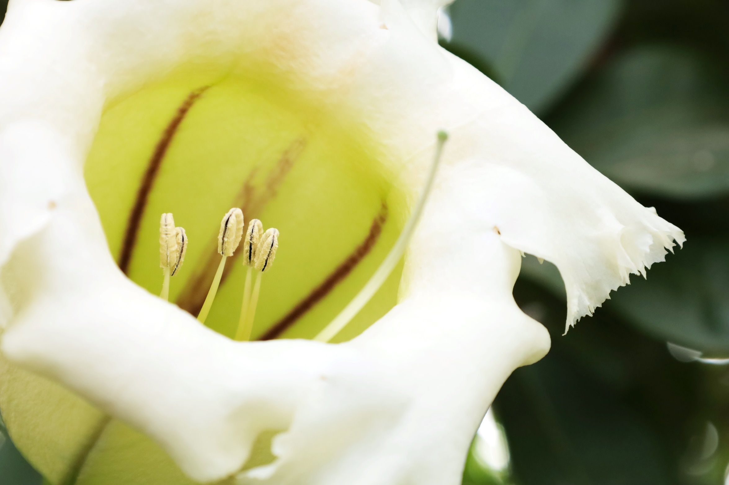
Anther
The anther makes the pollen. This pollen is taken to another plant by an insect to pollinate it.

Slide 15
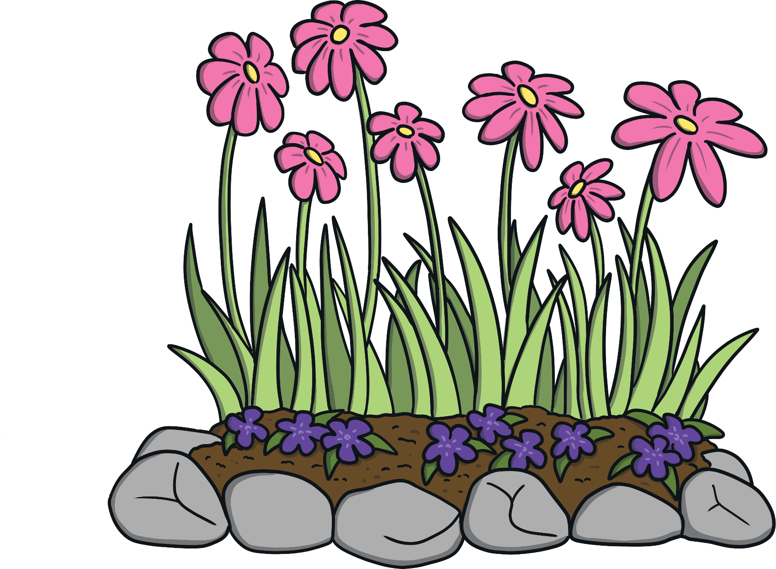
Turn and Talk
Tell your partner where the pollen is taken to on the other plant.

Slide 16
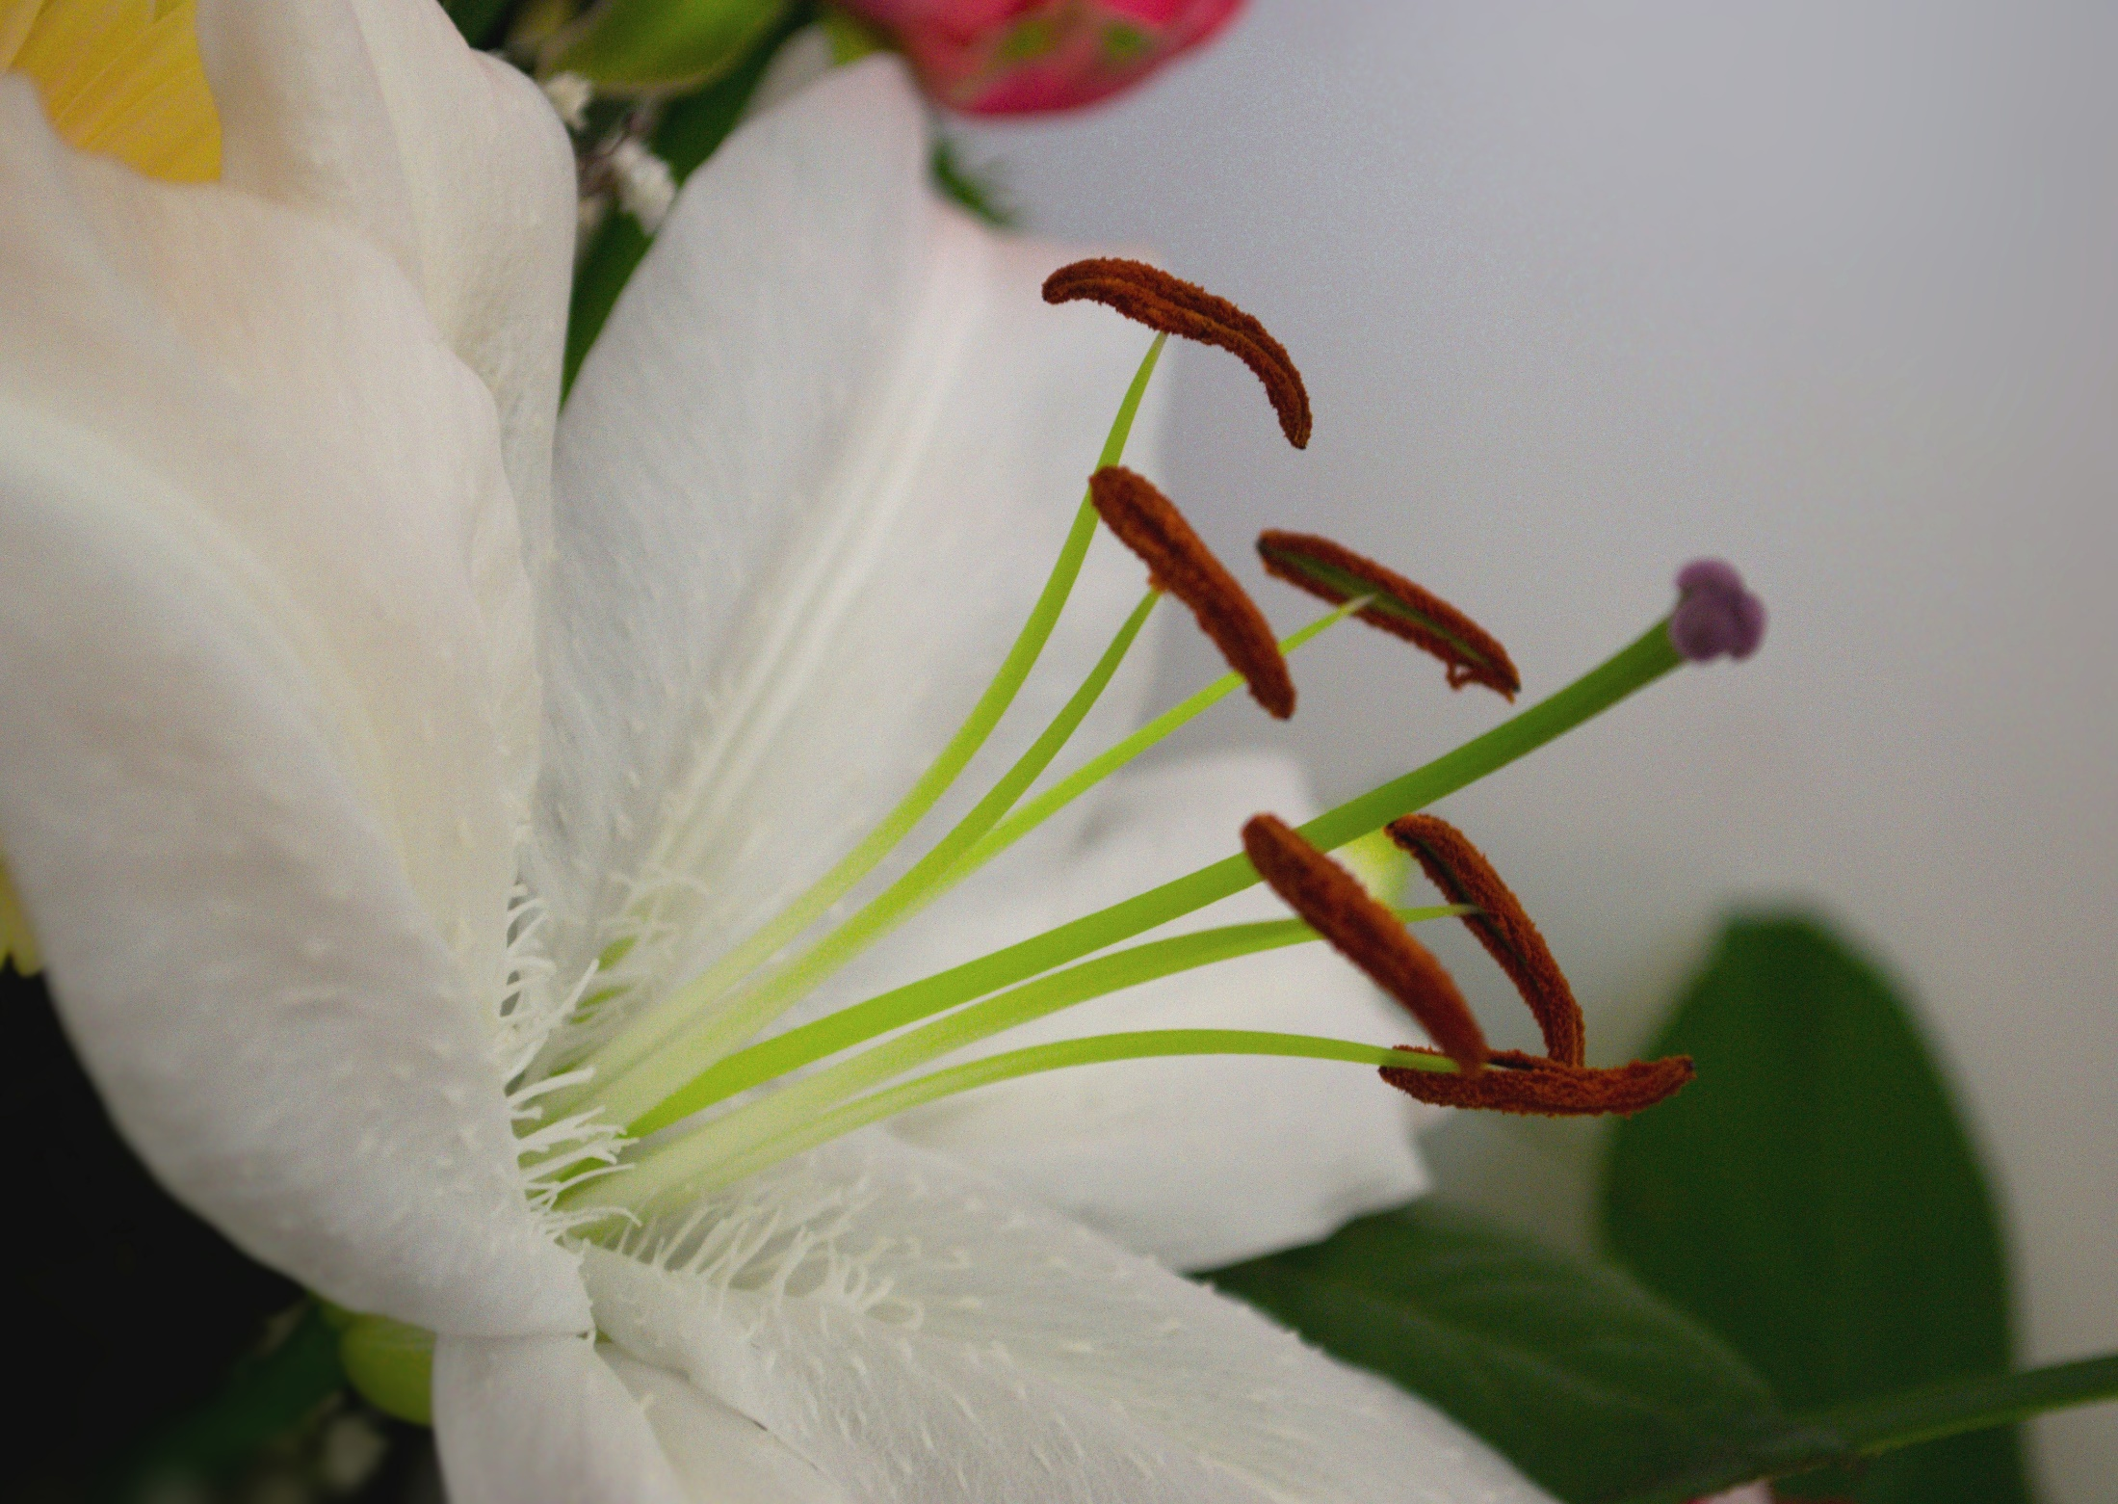
Filament
The filament holds up the anther to help insects reach it. If the anther is too low, an insect won’t be able to get pollen.

Slide 17

Turn and Talk
What would happen if an insect couldn’t collect pollen from a flower?

Slide 18
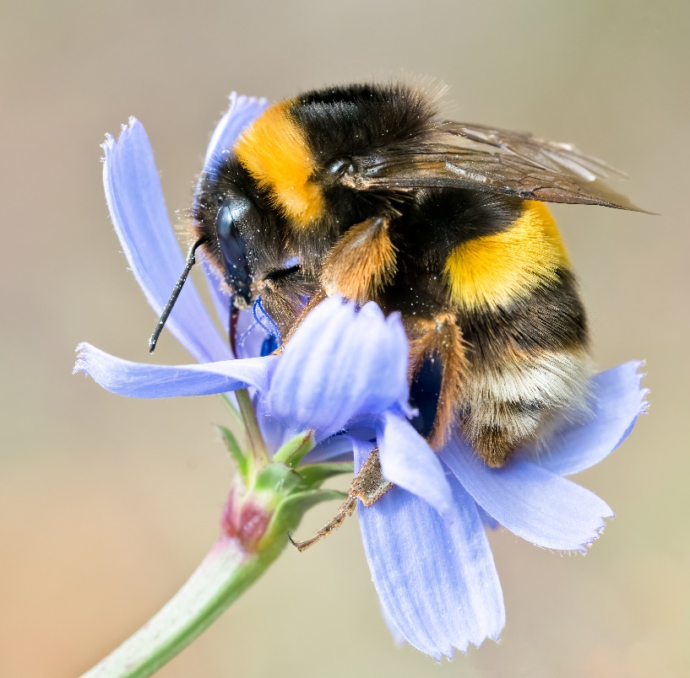
Insects in Pollination
Insects are a very important part of pollination. They help pollen go from one plant to another.
However, they do not do their job on purpose. They are just looking for food.

Slide 19
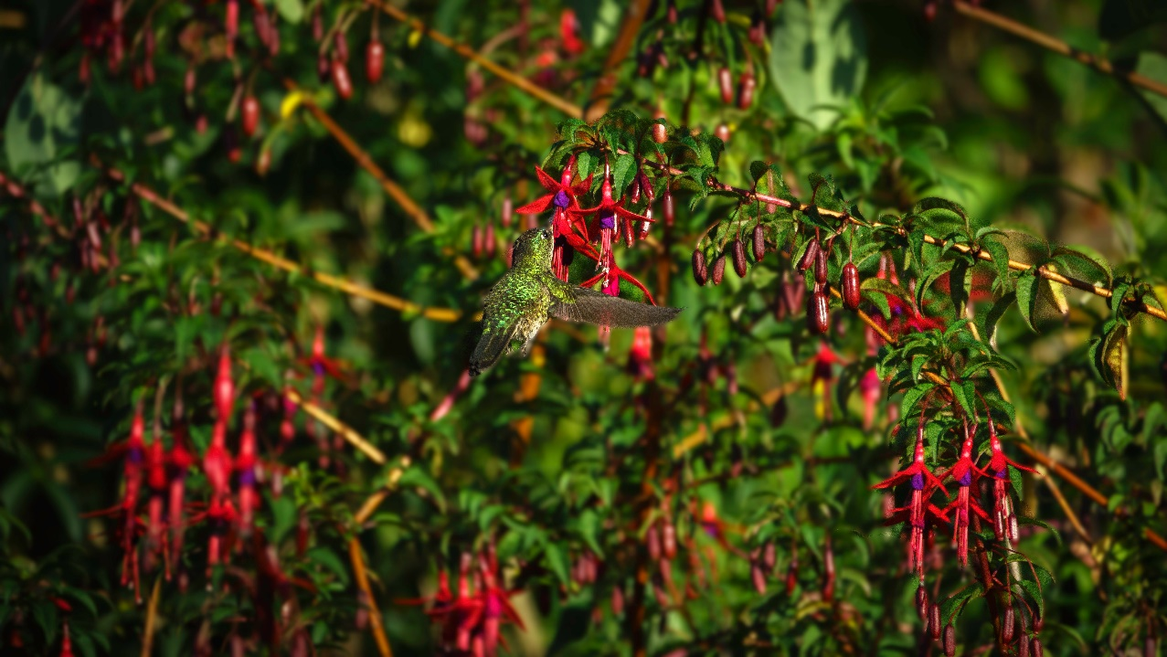
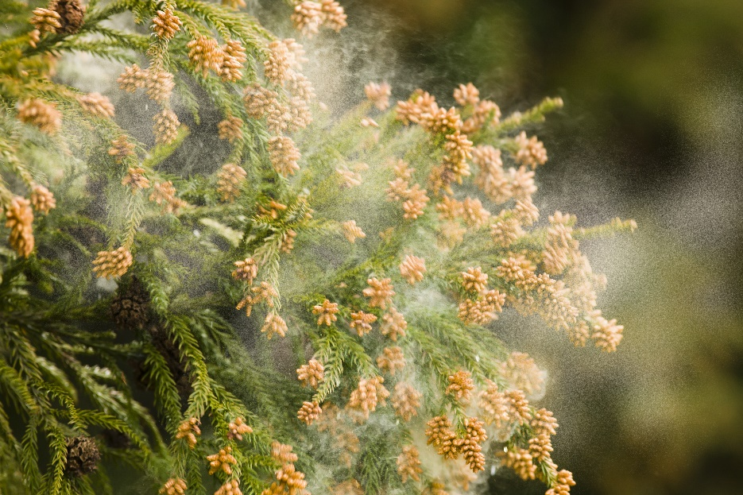
Other Pollinators
Insects are not the only pollinators.
Hummingbirds love to eat the nectar from plants like bee balm and honeysuckle. Just like insects, they pick up pollen and take it to other plants.
The wind is also a pollinator. When the wind blows, it moves pollen from grass and trees to other plants.

Slide 20
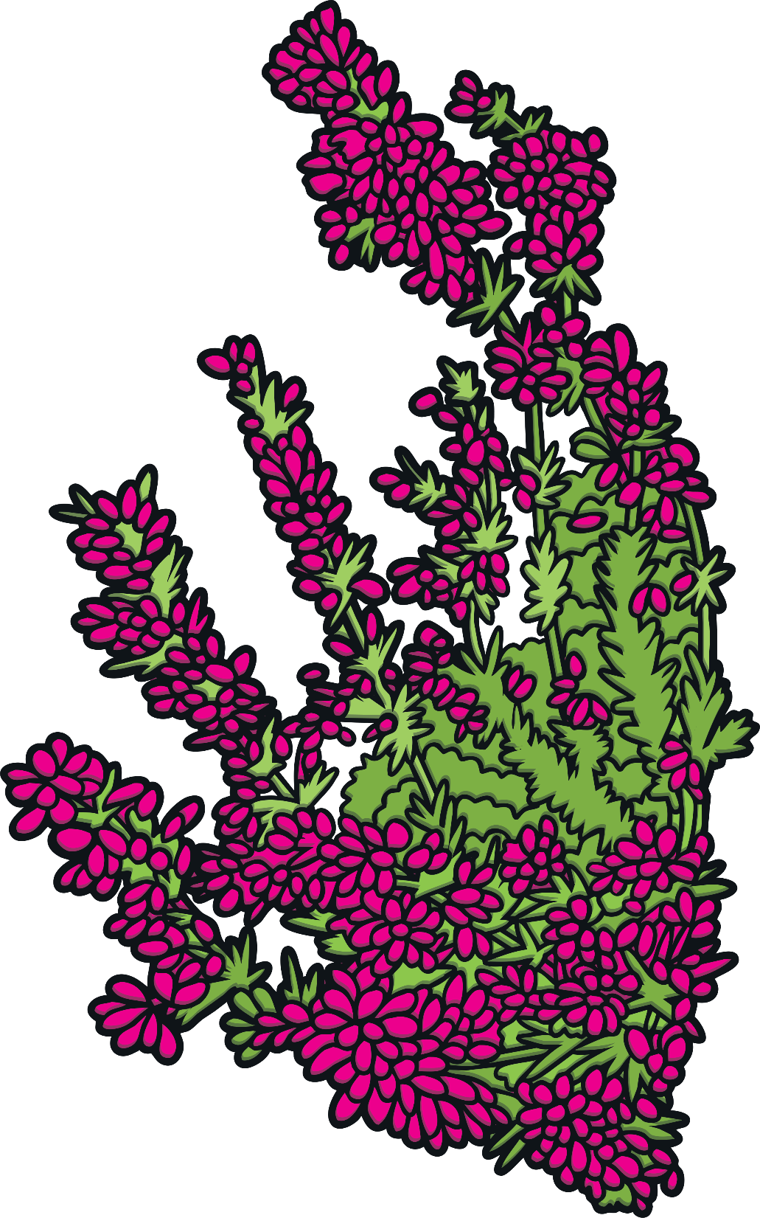
Turn and Talk
Name two pollinators.

Slide 21
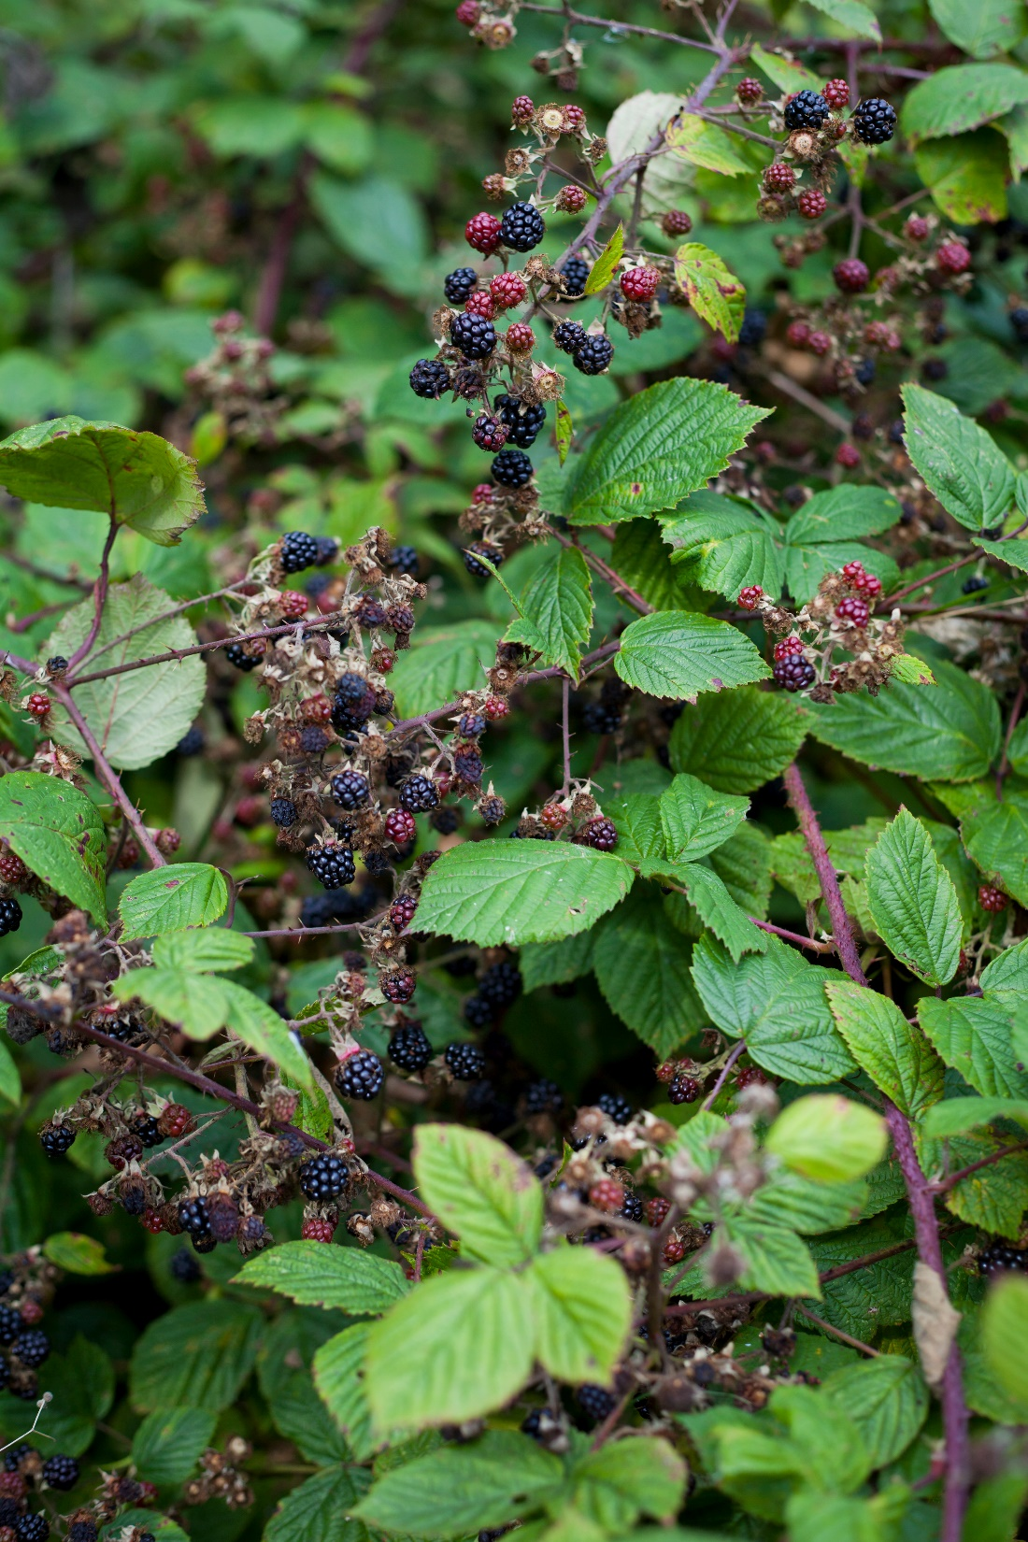
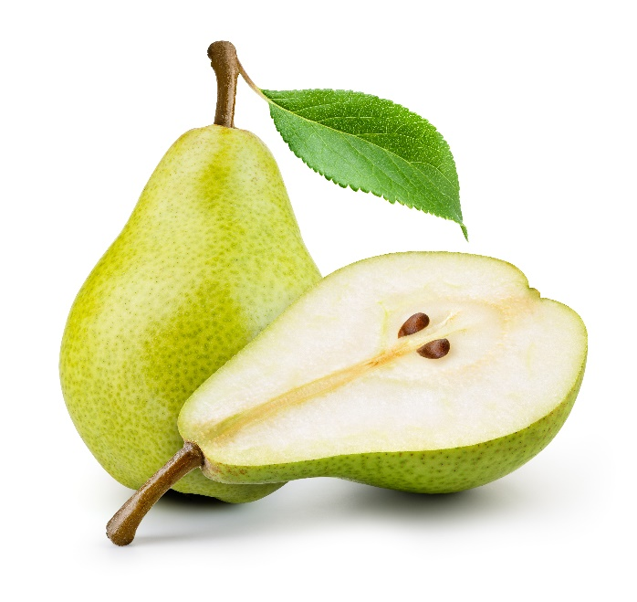
Pollination
Pollination helps our ecosystem stay strong and healthy. Some of the foods you eat that need pollination are apples, grapes, tomatoes, blackberries, avocados, peaches, pears, eggplants, and lemons.

Slide 22

Exit Ticket
What other foods do you think depend on pollination?

